Slide 1
ONLINE SHOPPERS INTENTION
SUBMITTED BY : UMA MAHESWARI B
DATE: 07.01.2022

Slide 2
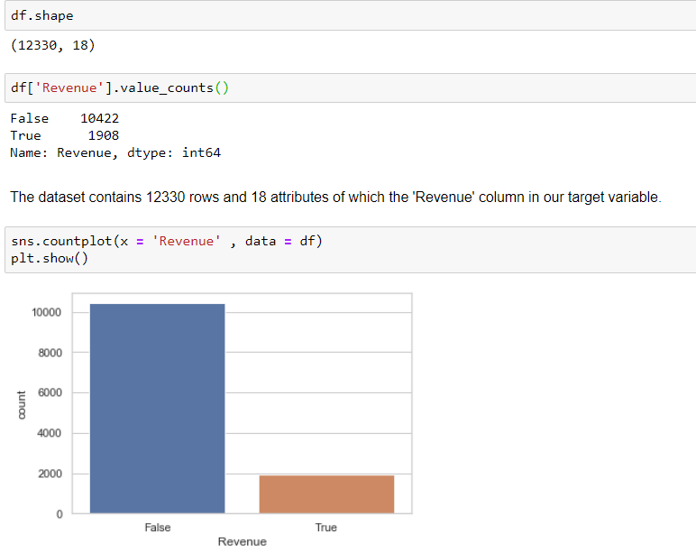
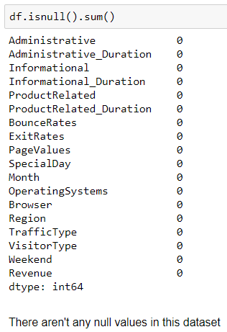
EDA
The dataset consists of feature vectors belonging to 12,330 online sessions.
Out of which
Numerical Features – 14
Categorical Features - 2
Boolean Features - 2
We use Revenue as our target variable and it’s in a Boolean Format

Slide 3
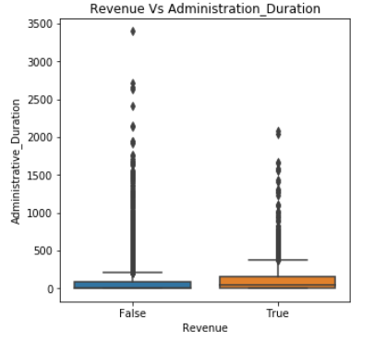
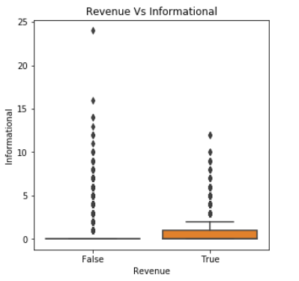
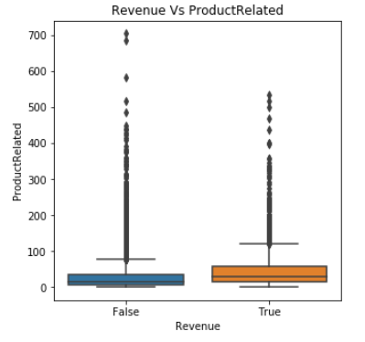
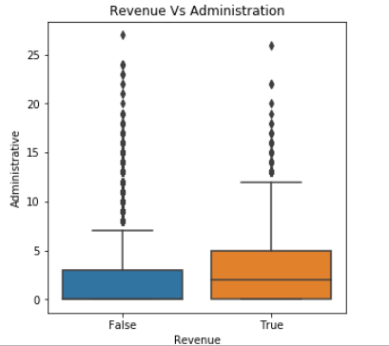
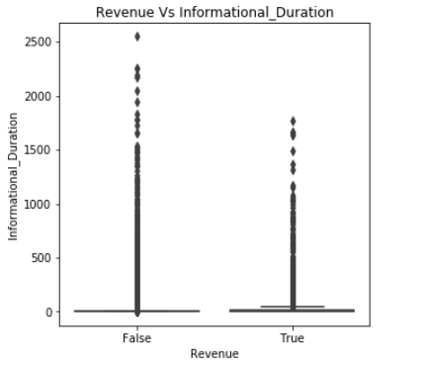
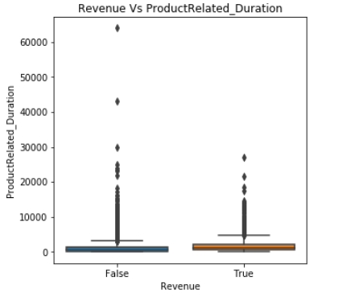
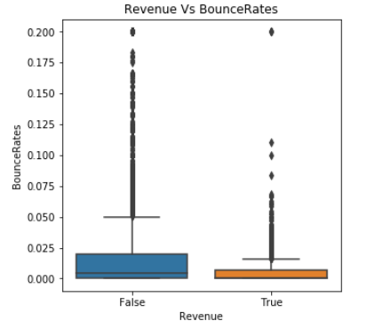
Boxplots for detecting Outlier Behaviour

Slide 4
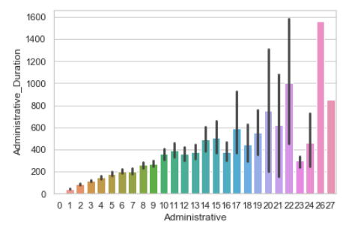
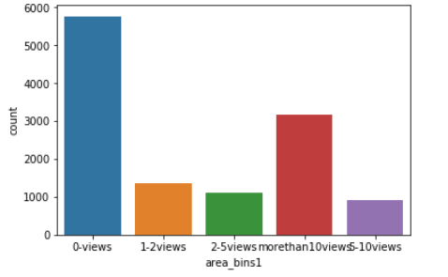
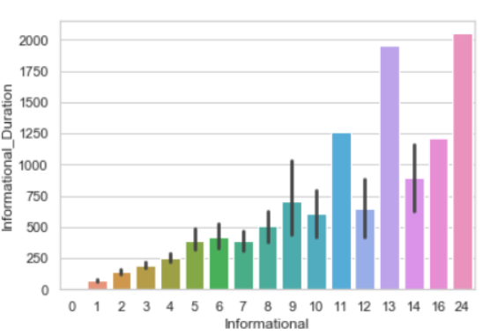
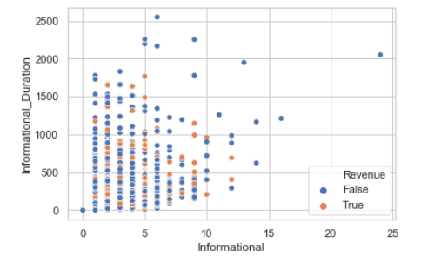
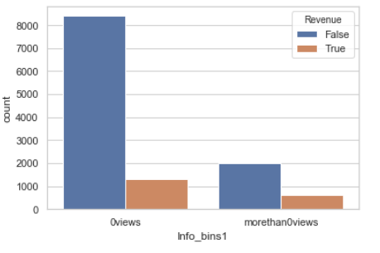
Administration Related Issues
Graph 1 shows the distribution for count of admin related issues vs duration spent on them.
We can see that there is a general Uptrend.
In graph 2 we have created bins for admin related count and we can see that people who didn’t have any admin issue is highest.
However there are lot of people who visited admin related content more than 10 times also.
This tells us that we might need to look into our tech support and IT content and improve them.
Information Related Content
Graph 3 shows the count of info related websites visited by the user vs duration spent on it.
We see that this is also on a general uptrend.
Graph 4 shows people who research too much don’t end up buying.
Ideal region – people who visit below 5 info related content and spend below 1000secs.
Graph 5 show that conversion percentage is higher for people who have visited info related content ( ie: people who have done their research)

Slide 5
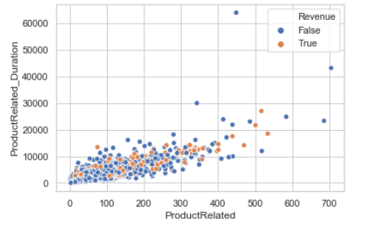
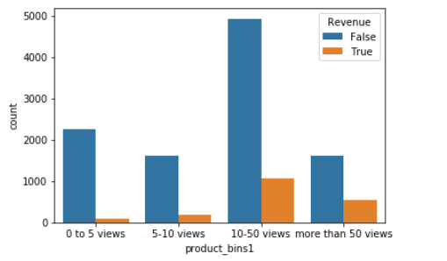
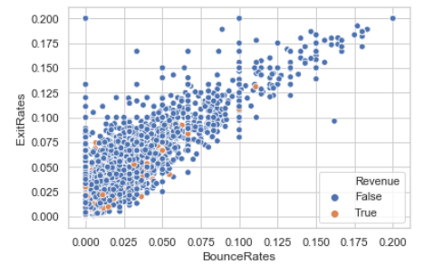
Product Related Analysis:
Graph 1 is a plot of Prouct related pages viewed vs amount of time spent.
We find the conversion points(orange) to be distributed throughout.
Graph 2 is a bin-wise analysis and we find conversion percentage to be highest for people who visit more than 50 times followed by people who visit 10-50times.
Business Insight:
Our target customers are the ones who visit the product from 10 to 400 times. The outliers generally do not end up purchasing.
Bounce Rates & Exit rates Analysis:
Graph 3 shows bounce rates and exit rates w.r.t Revenue.
We can see the vast majority of people who bounce or exit the website don’t make a purchase.
Business Insight :
We do not need to allocate resources to improve user experience for people with high bounce and exit rates . Only few people in the lower spectrum end up making a purchase.

Slide 6
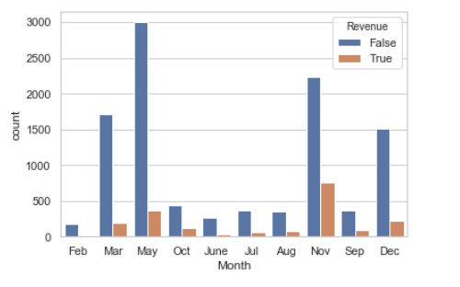
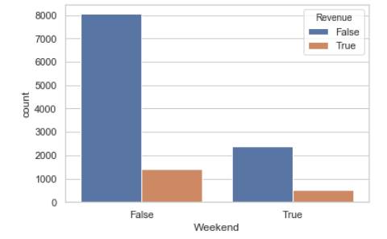
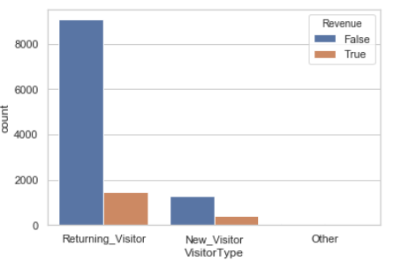
Month Vs Revenue :
Weekday Vs Weekend Revenue:
Visitor Type Vs Revenue:
The footfalls is highest in May followed by November.
However , conversion percentage seems to be low in May, this might be a good time to give blockbuster discounts and EOS sale to boost conversion rate.
The sale seems to be good in Nov , it’s a good idea to stock up extra inventory and also offer good discounts in Nov.
There is very few footfall and almost zero purchase in Feb , we might need to look into that as well.
The number of footfalls seem to be higher on weekdays compared to weekends.
However, the conversion rate seems to be slightly better on weekends.
A good way to attract more people to the website and improve conversion rate would be to send notifications to users regarding weekend discounts right from Thursday or Friday.
Here we see that footfalls for returning visitor is way higher compared to new visitors , however the conversion rate of new visitors is higher compared to returning visitor.
To honour returning visitors we could introduce loyalty points and bonuses which they could redeem if they are a returning user.
Since the no of new visitors is very low we might need to look into our digital marketing and SEO options to increase footfalls.

Slide 7
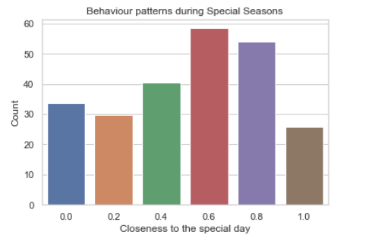
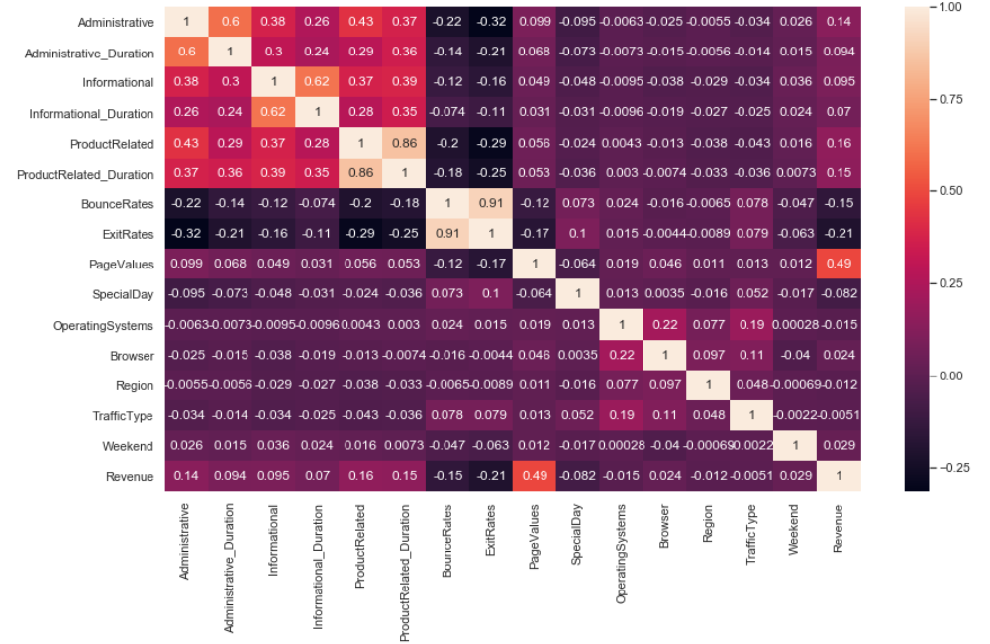
1.0 :- Represents the special day(eg :Christmas , Halloween , thanksgiving)
0.0 : - Represents all the 11 months preceding the special day. (eg : nov 1 to sep 30 on the case of Halloween)
0.2 to 1.0 – each of the decimal bucket represents 6 days from oct 1 to oct 30 with 0.2 being toward the week on the start of the month and 0.8 being the week before the special day.
Insights:
We find that there is a general uptrend in buying pattern as the special day approaches and peaks during the 2 weeks preceding the festival and drops down on the day of the festival itself.
It might be a great idea to stock up on extra inventory and offer special discounts and gift cards during these couple of weeks before the holiday season to boost sales even further.
This heatmap shows the correlation of every variable in our dataset with one another;
We find only 2 attributes to have a high-correlation value of more than 0.7.
They are :
ProductRelated_Duration and ProductRelated with a correlation coeff of 0.86
ExitRates and BounceRates with a correlation coeff of 0.91

